Slide 1
Geological Time Scale
Year 10 Pre-ATAR Science

Slide 2
Review questions
What is the fossil record?
What is an index fossil?
What is the difference between a direct and indirect fossil?
Explain the law of superposition.
Explain relative dating.
Explain radioisotopic (radiometric) dating.

Slide 3
Learning Intentions
Describe the Geological Time Scale

Slide 4
Success criteria
Define stratigraphy
Relate geological time scale to the fossil record
Rank geological time units from largest to smallest duration
Explain that the fossil record was used to divide history into time units, based on significant events
Give one example of an eon, era, period, epoch and age

Slide 5
Geological time scale and the fossil record
The fossil record shows change in living things over time.
Particular species characterise particular parts of the fossil record.
Both relative and radioisotopic dating were used to quantify the fossil record, to product the geological time scale.

Slide 6
The Geological Time Scale
Radiometric dating estimates that the Earth is 4.54 billion years old.
Geologists have divided Earth’s history into a series of time intervals.

Slide 7
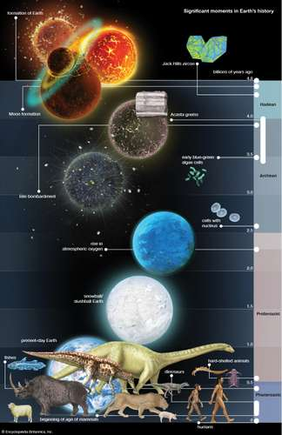

Slide 8
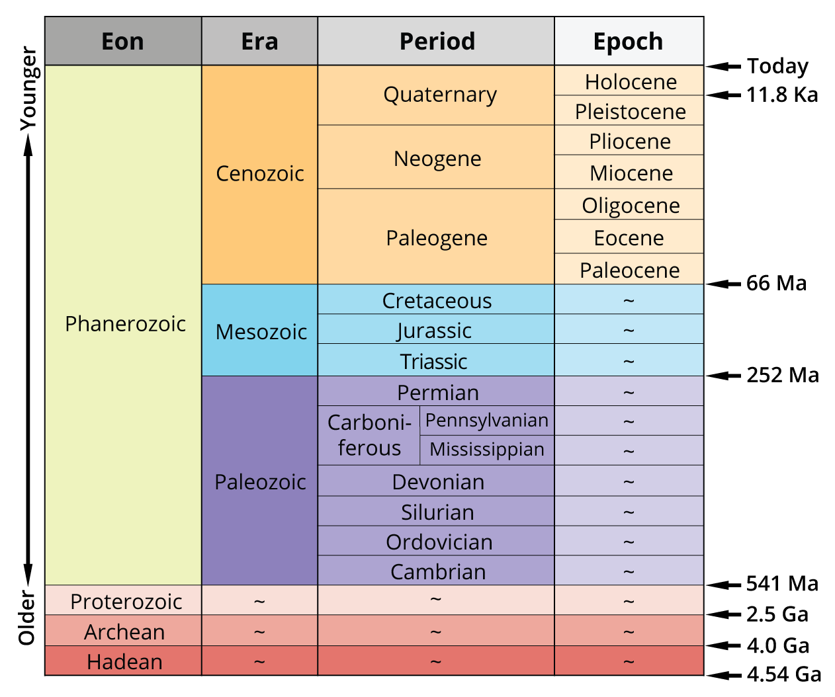

Slide 9
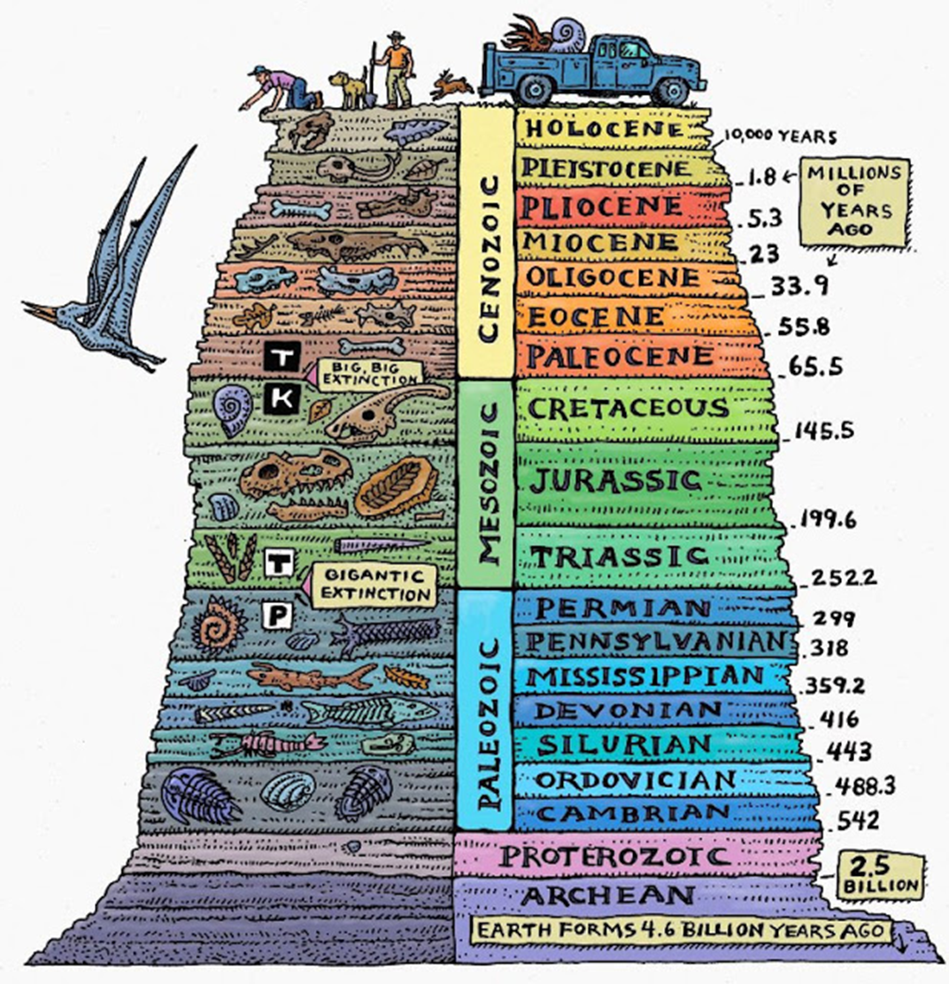
Time travellers guide to …
Set your dial to…
You will expect to see…
This time period is a(n) …

Slide 10
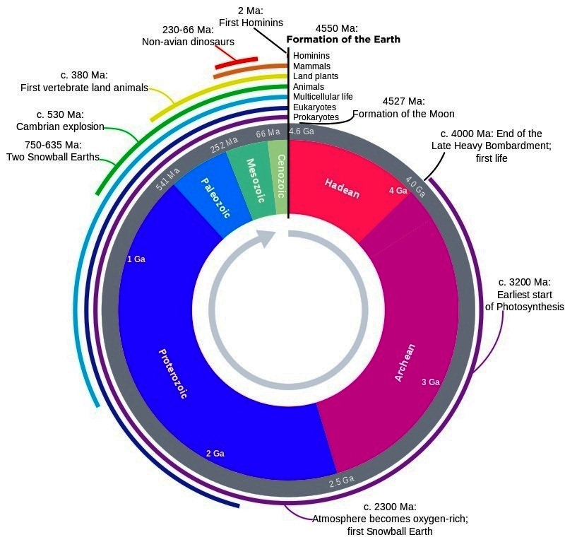

Slide 11
Success criteria
Define stratigraphy
Relate geological time scale to the fossil record
Rank geological time units from largest to smallest duration
Explain that the fossil record was used to divide history into time units, based on significant events
Give one example of an eon, era, period, epoch and age

